Slide 1
Introduction of gogolib4java
Xiong Hongyu
July 20, 2011

Slide 2






Software Libraries of GoGo Board Except GoGo Monitor
Microworlds
Netlogo
Scratch
C#
Flash
c/c++ visual basic

Slide 3
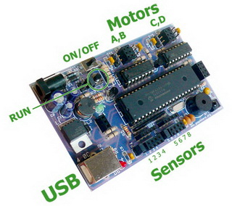

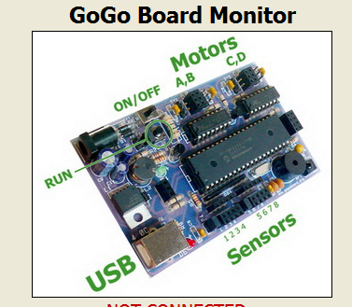
Java API for GoGo Board

Slide 4
gogolib4java
http://code.google.com/p/gogolib4java/
Java API to work with GoGo Board.
GoGoSerialPort
GoGoClient

Slide 5
Current Class Summary of gogolib
GoGoClient
class to communicate with one GoGo Server embedded in GoGo Monitor
GoGoSessionManager
class to manage multiple connections to GoGo Server
GoGoSerialPort
class to work with local connected GoGo Board
GoGoConsole
a Command-Line application to manipulate local connected GoGo Board
GoGoMonitor
a GUI application to manipulate local connected GoGo Board

Slide 6
GoGoClient Class
Class to work with a remote GoGoServer

Slide 7
Example1 Beep.java
import kr.ac.scnu.cn.gogolib.GoGoClient;
public class Beep
{
public static void main(String[] argv)throws Exception{
// connect to local running GoGo Monitor
GoGoClient ggClient = new GoGoClient("localhost", 9873);
ggClient.beep();
System.out.println(ggClient.receive());
ggClient.close();
}
}

Slide 8
Example2 LedController.java
import kr.ac.scnu.cn.gogolib.GoGoClient;
public class LedController
{
public static void main(String[] argv)throws Exception{
// connect to local running GoGo Monitor
GoGoClient ggClient = new GoGoClient("localhost", 9873);
//the argument should be 'on' or 'off'
if( argv[0].equalsIgnoreCase("on"))
ggClient.ledOn();
if( argv[0].equalsIgnoreCase("off"))
ggClient.ledOff();
System.out.println(ggClient.receive());
ggClient.close();
}
}

Slide 9

GoGoSerialPort Class
GoGoSerialPort
Serial Port Connection

Slide 10
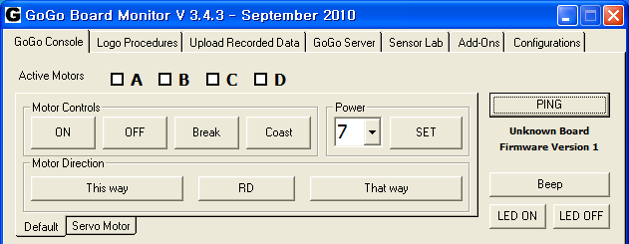
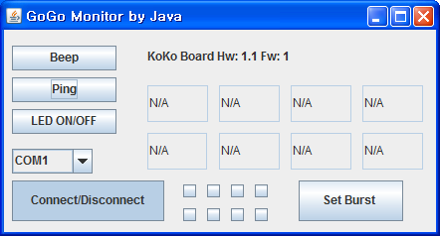


GoGoMonitor class
PING COMMAND

